Slide 1


Fixed Assets Management
in
Tally.ERP 9
Presented by New Access Technologies., Bangalore
©New Access Technologies., All rights are reserved.

Slide 2
About Us
New Access Technologies is a business software applications management company, entirely focused in providing solutions and services on Tally.ERP 9 technologies addressing business critical needs of small, medium and large enterprises.
Implemented 50+ end-to-end enterprise solutions on Tally.ERP 9
Highly experienced technical teams working on Tally Definition Language (TDL), .NET, C#, VB, Oracle, SQL Server, Java, Java Script, XML, HTML, XSLT, Web Services
Direct presence in Bangalore.
©New Access Technologies., All rights are reserved.

Slide 3
Fixed asset management – An Overview
©New Access Technologies., All rights are reserved.

Slide 4
Structure of Fixed Asset Management
Depreciation
Methods
MIS
Reports
Fixed Asset
Management
Asset
Classification
Asset
Depreciation
Capital
Purchase
Asset
Disposal
©New Access Technologies., All rights are reserved.

Slide 5
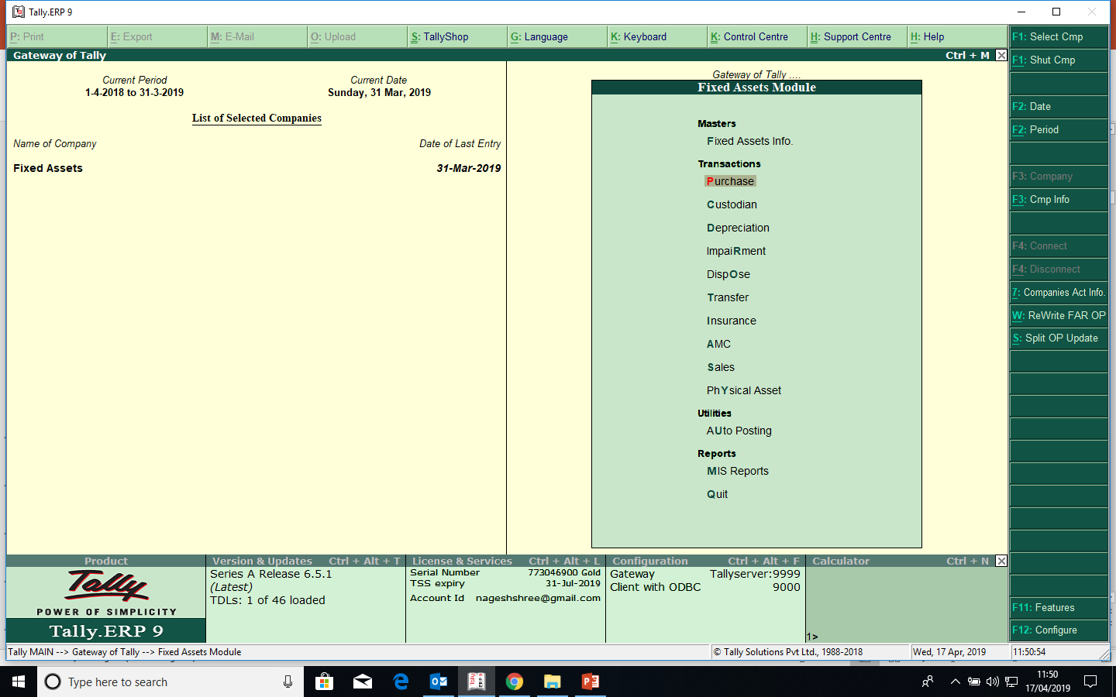
Gate Way of Fixed Assets
©New Access Technologies., All rights are reserved.

Slide 6
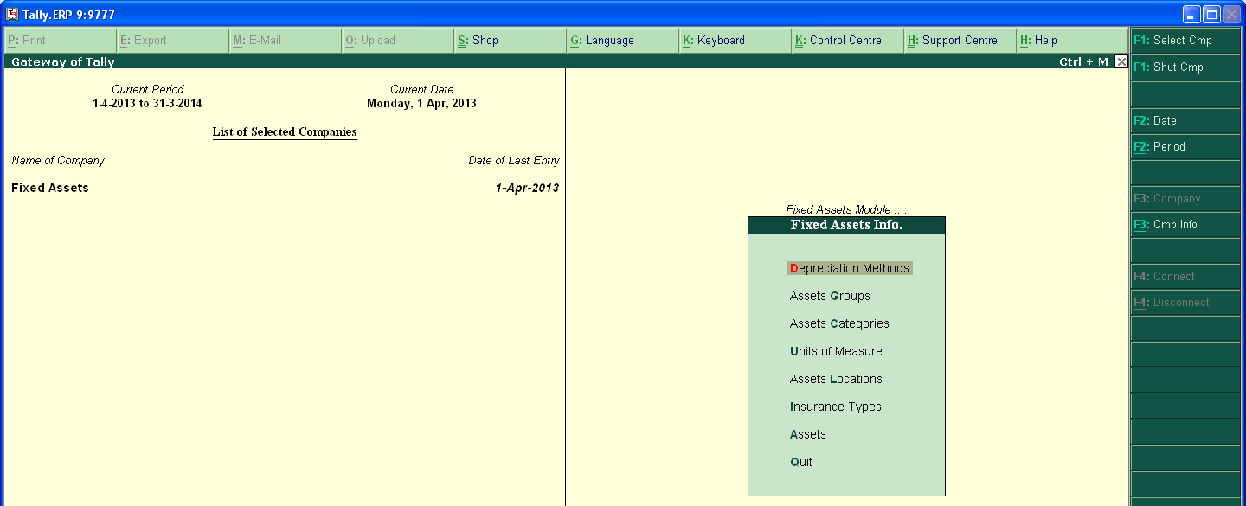
Masters Info
©New Access Technologies., All rights are reserved.

Slide 7
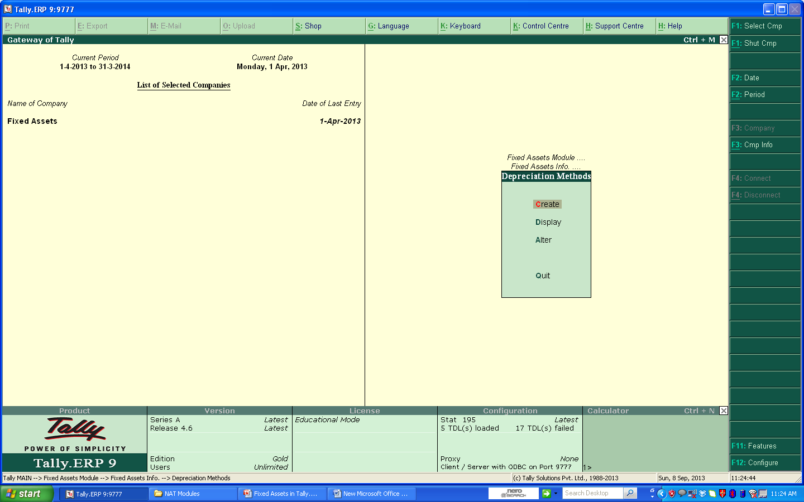
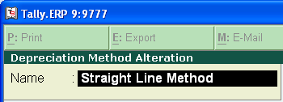
Depreciation Methods
©New Access Technologies., All rights are reserved.

Slide 8

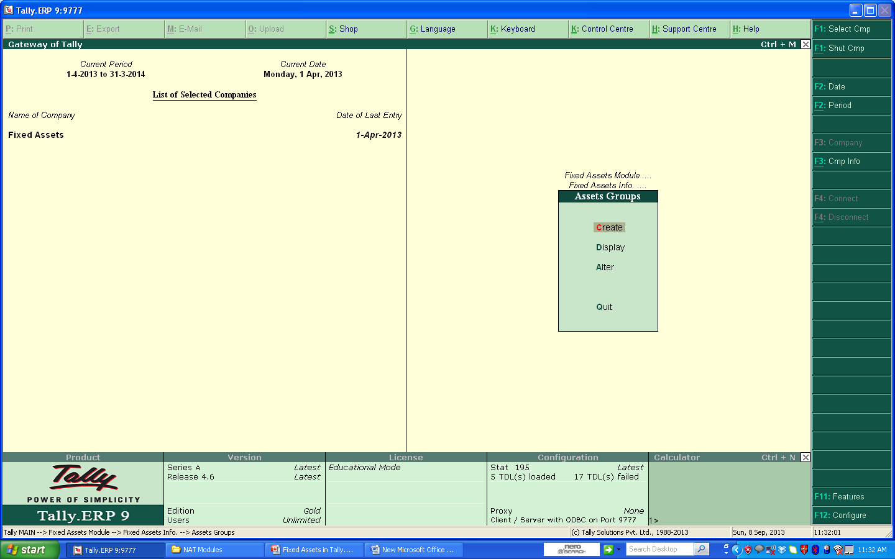
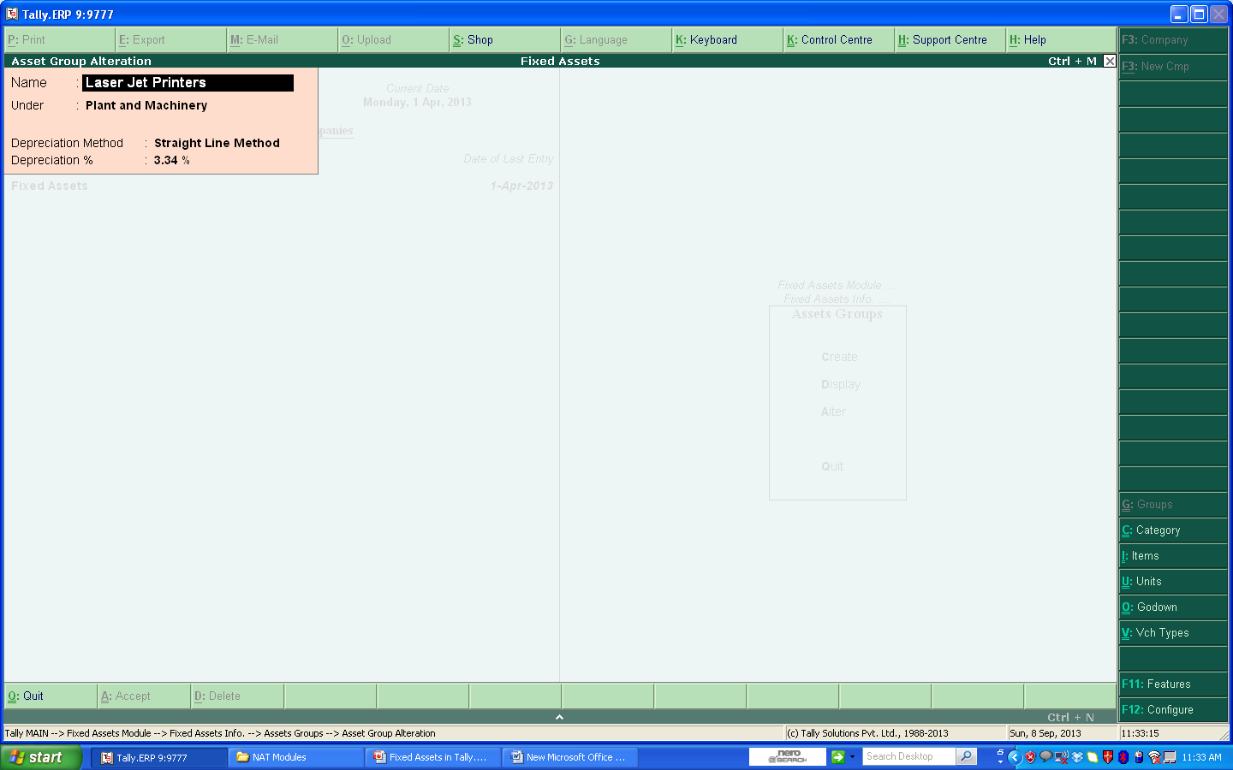
Assets Groups
©New Access Technologies., All rights are reserved.

Slide 9
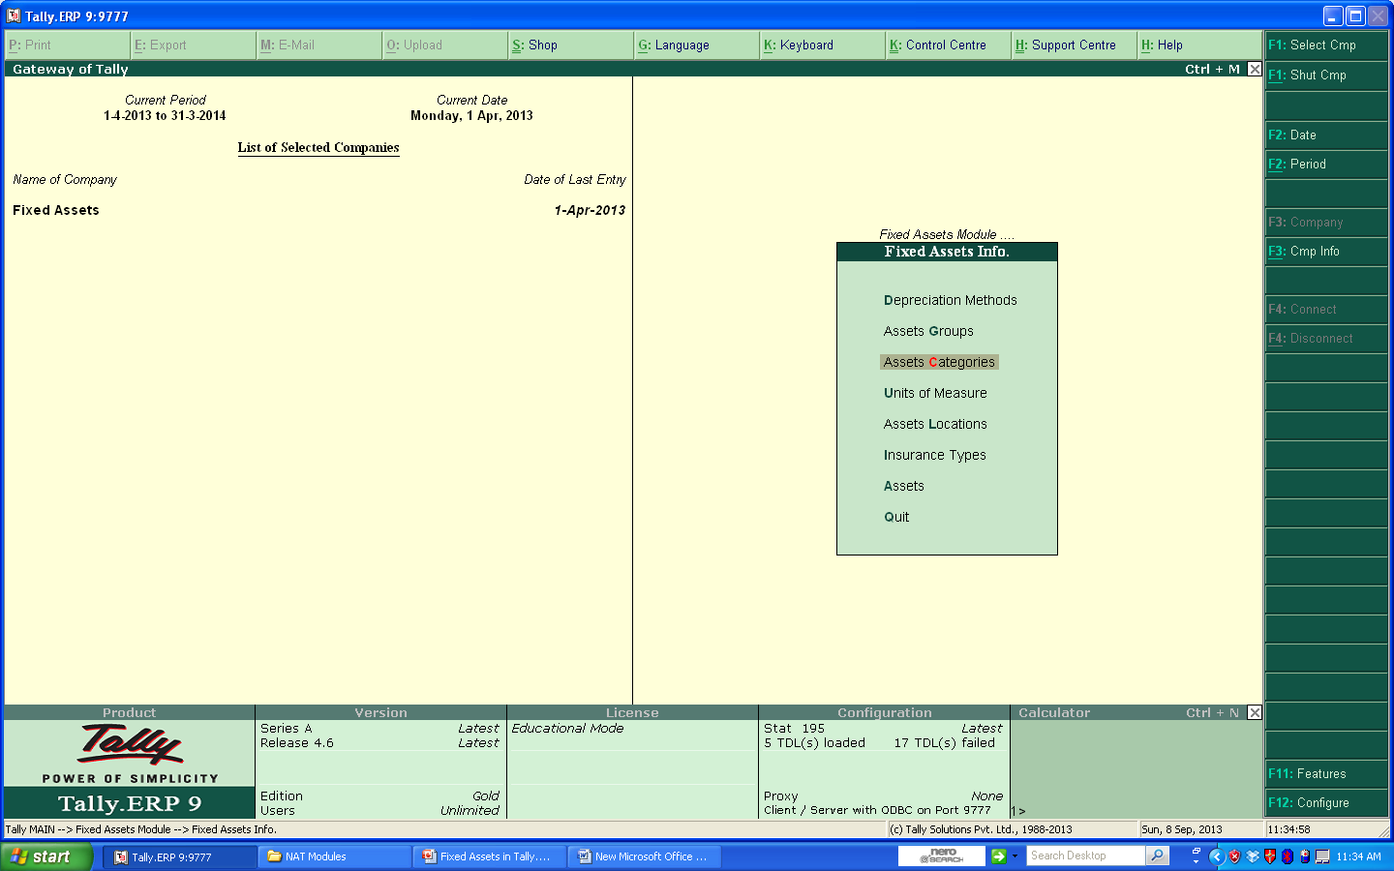
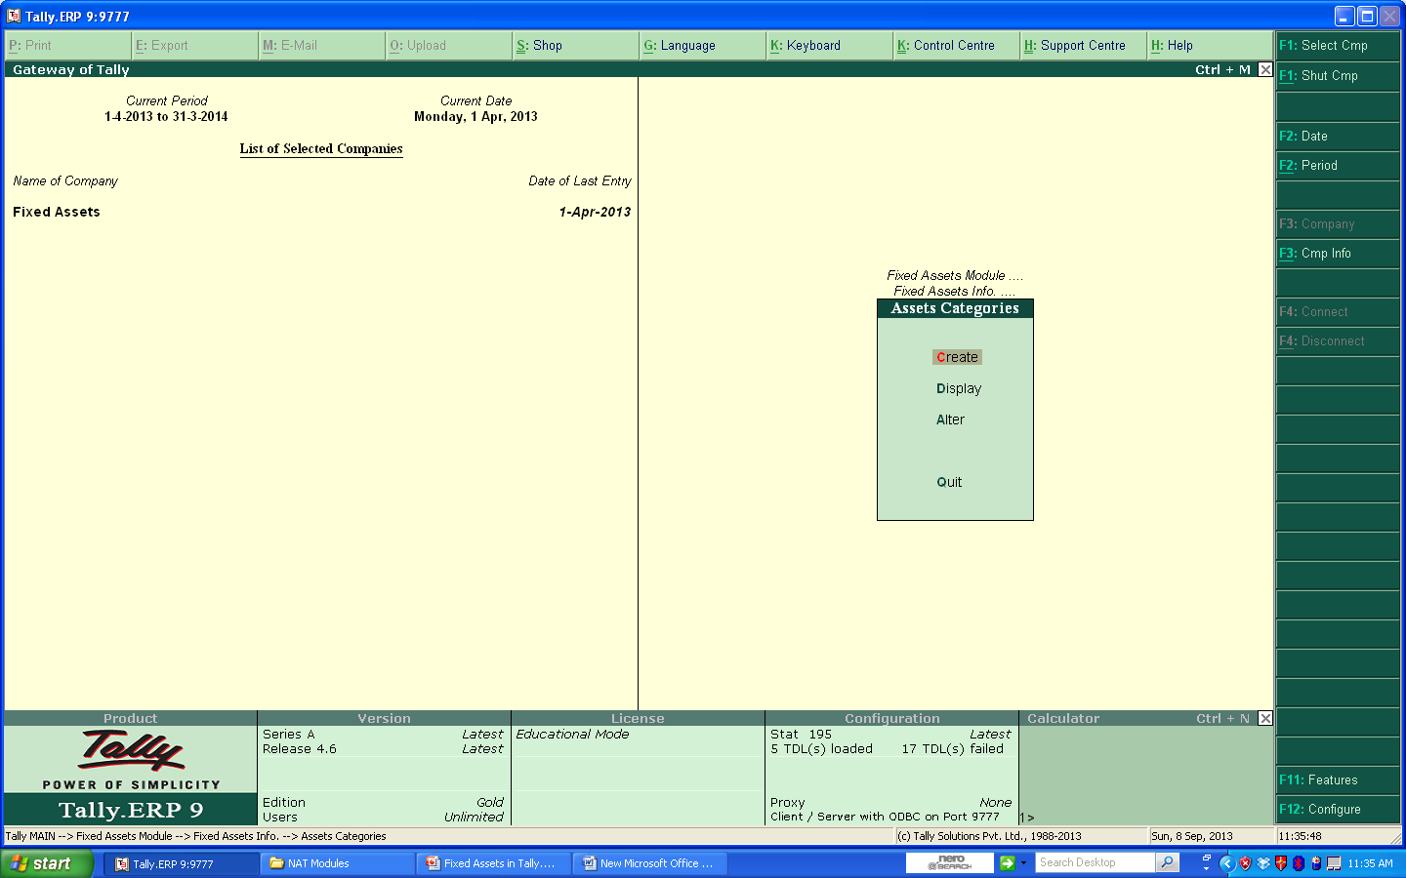
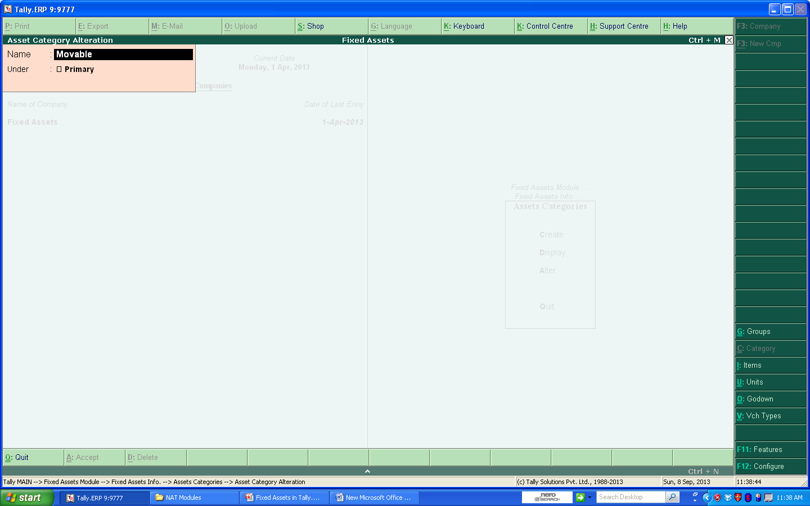
Assets Categories
©New Access Technologies., All rights are reserved.

Slide 10


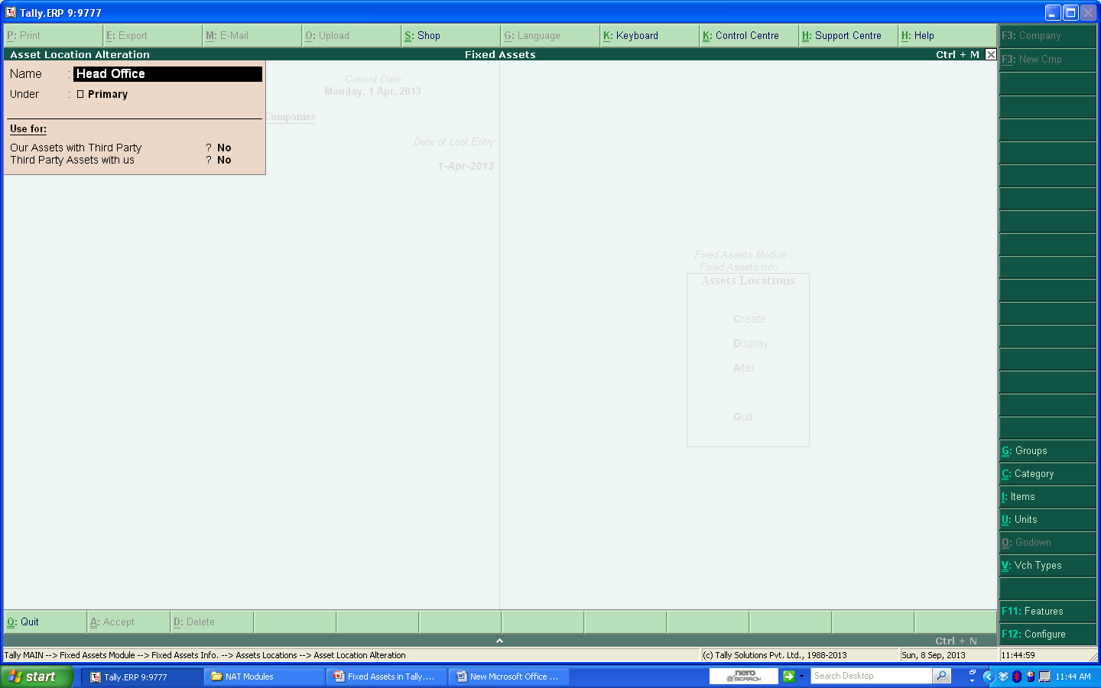
Assets Locations
©New Access Technologies., All rights are reserved.

Slide 11


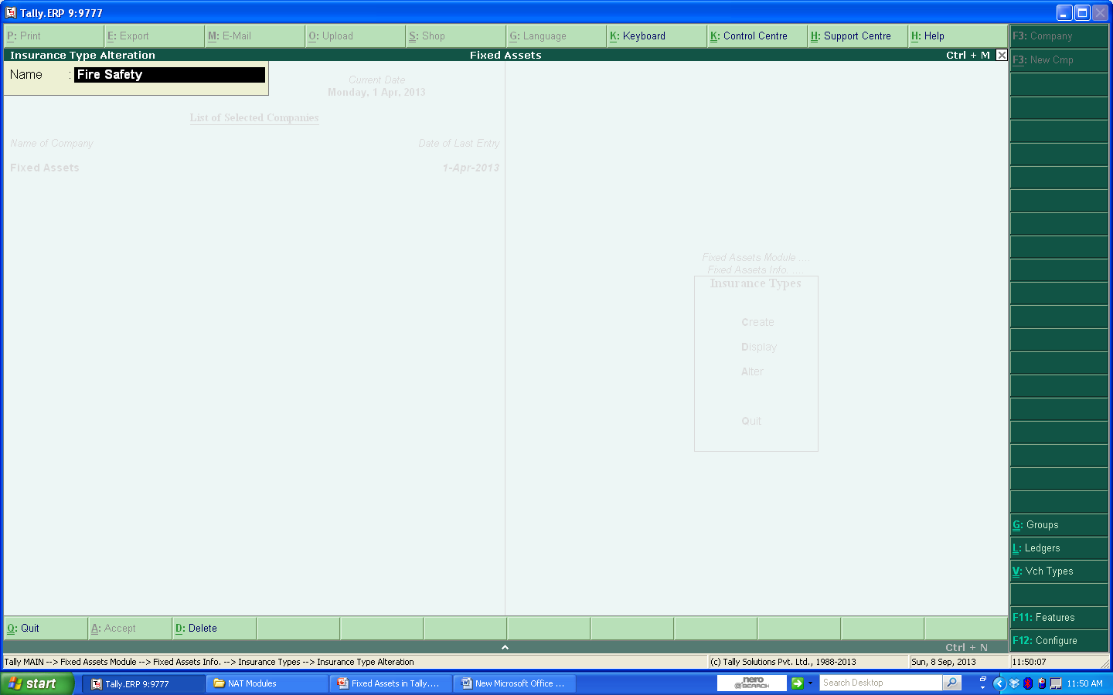
Insurance Types
©New Access Technologies., All rights are reserved.

Slide 12

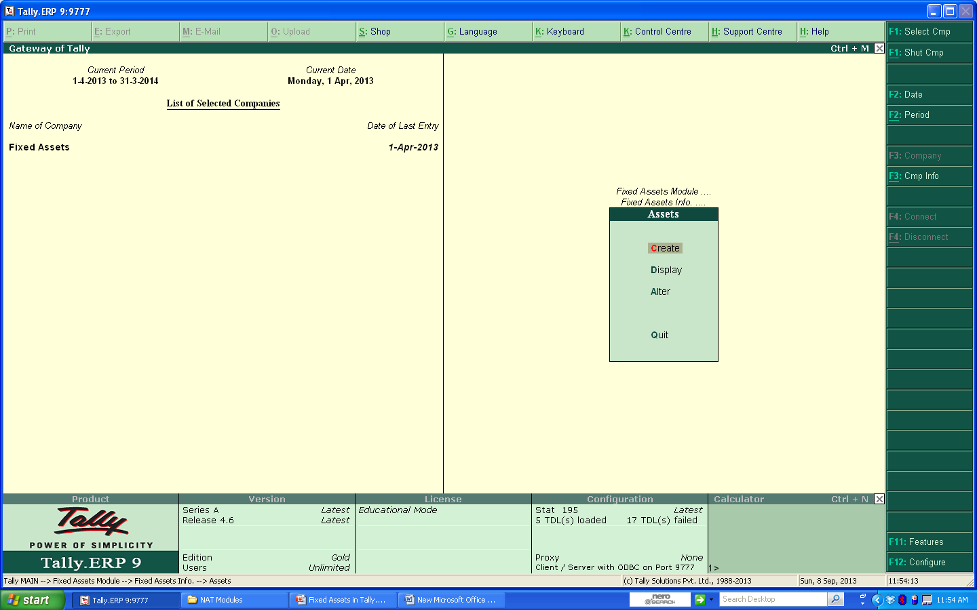
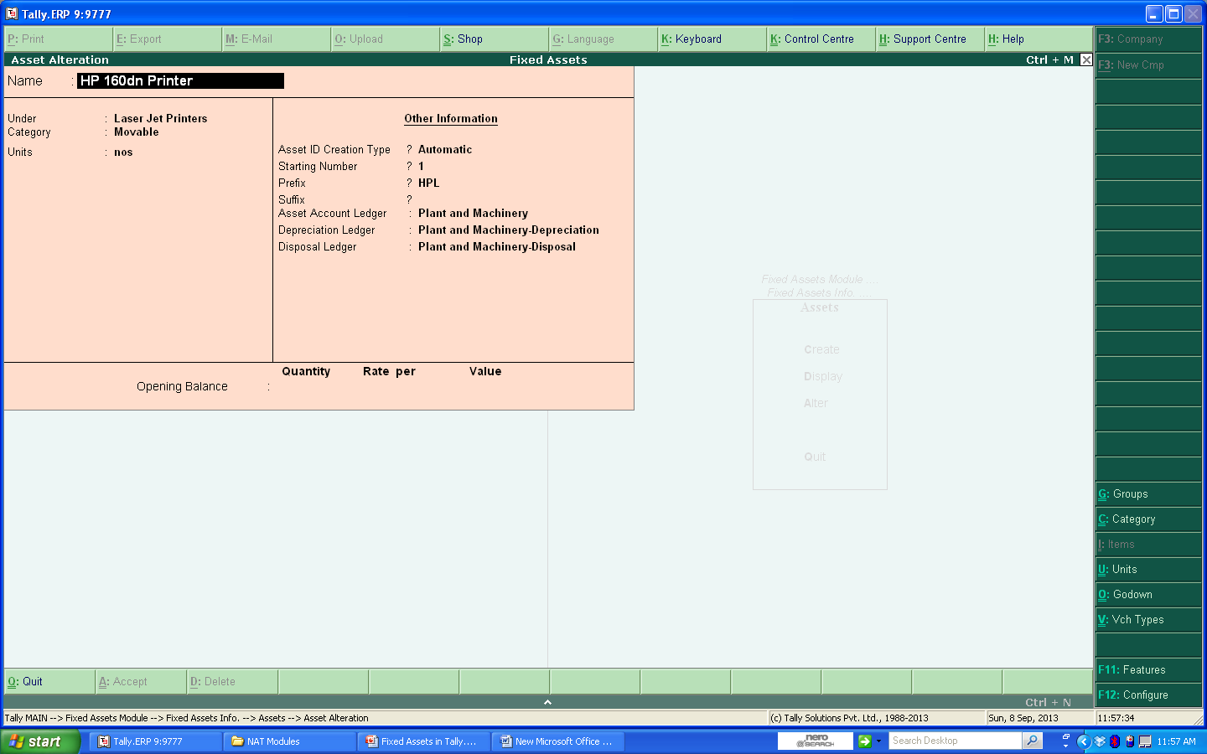
Assets
©New Access Technologies., All rights are reserved.

Slide 13
Transactions
©New Access Technologies., All rights are reserved.

Slide 14
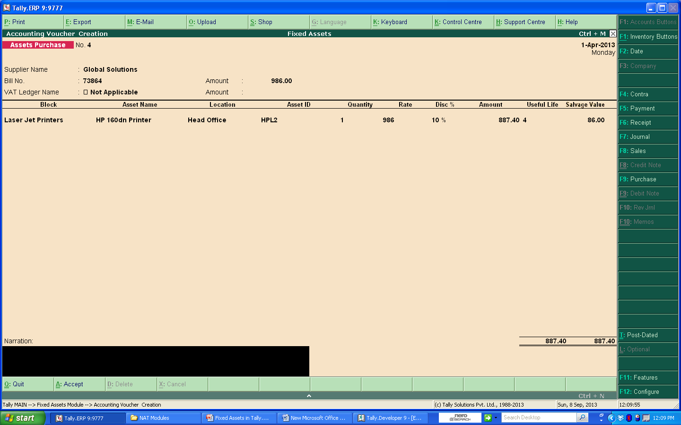
Purchase Voucher Creation
©New Access Technologies., All rights are reserved.

Slide 15
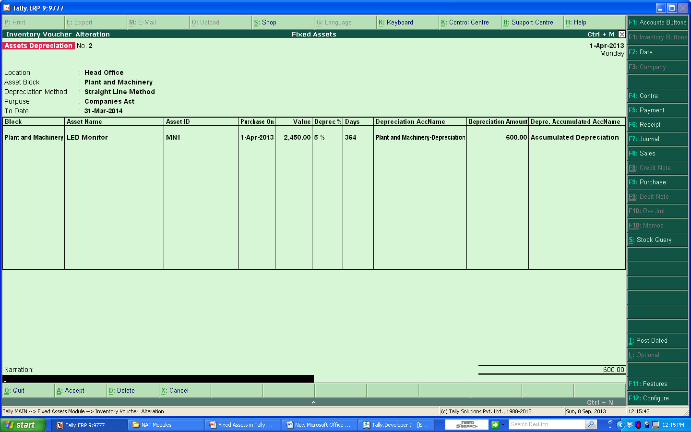
Depreciation Voucher Entry
©New Access Technologies., All rights are reserved.

Slide 16
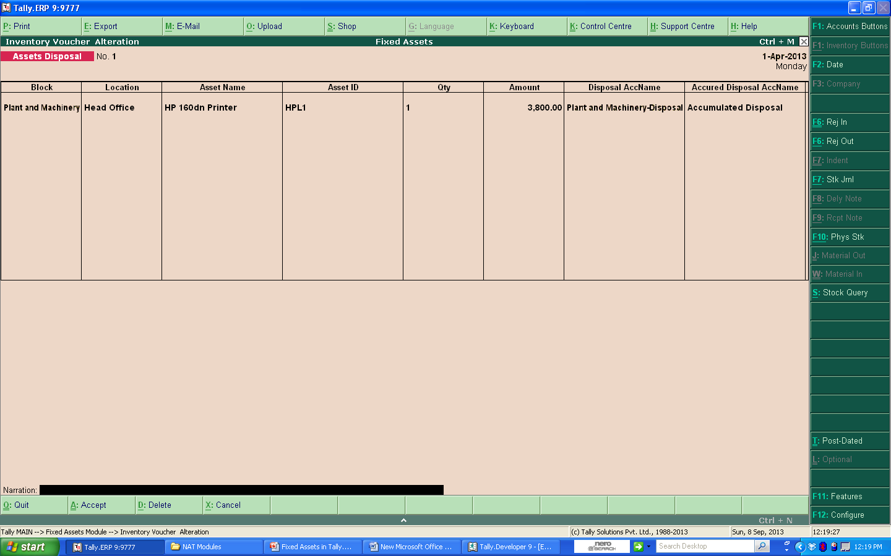
Disposal Entry
©New Access Technologies., All rights are reserved.

Slide 17
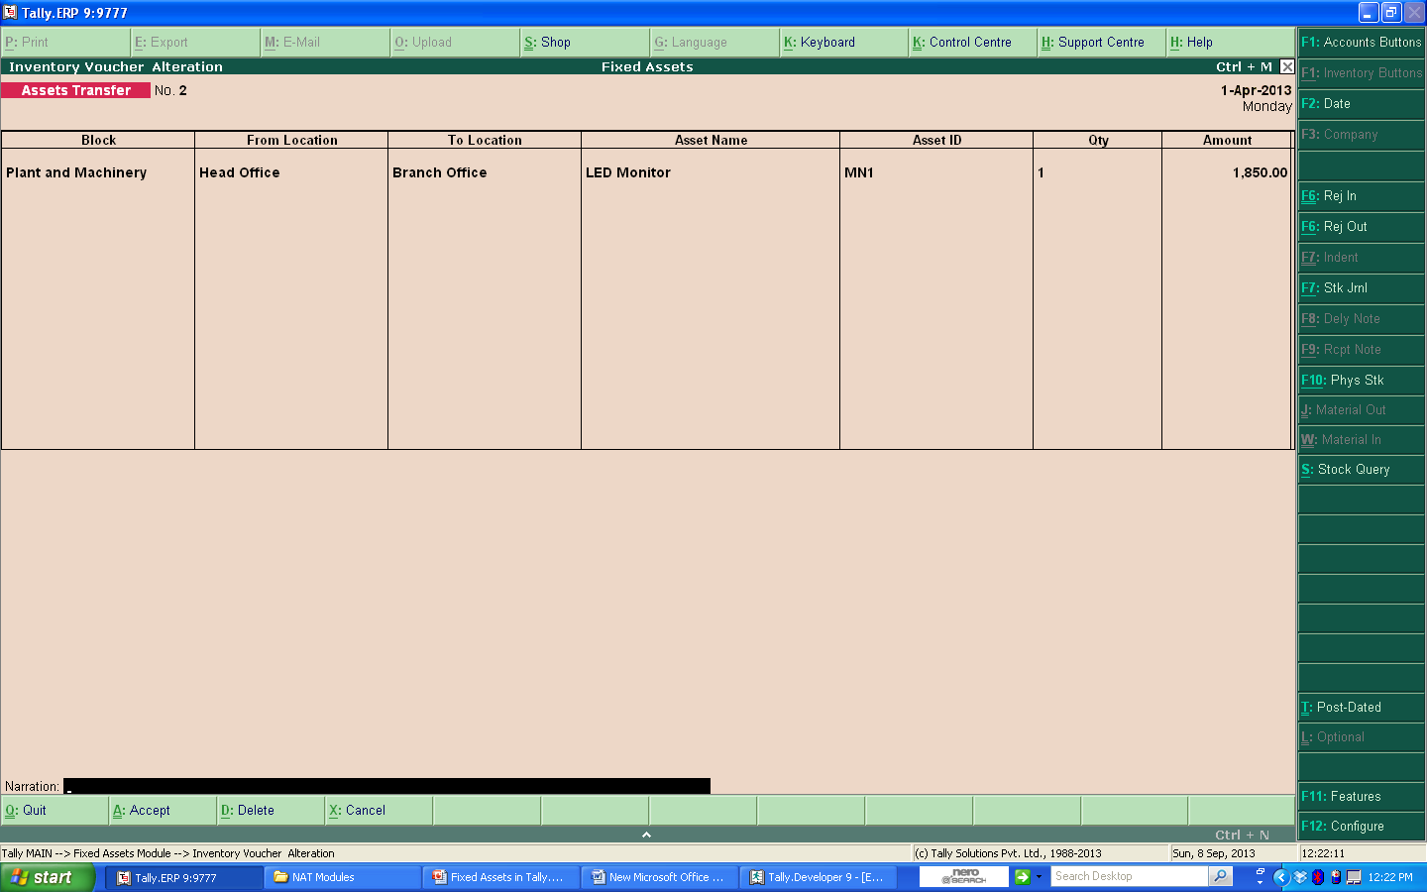
Asset Transfer Entry
©New Access Technologies., All rights are reserved.

Slide 18
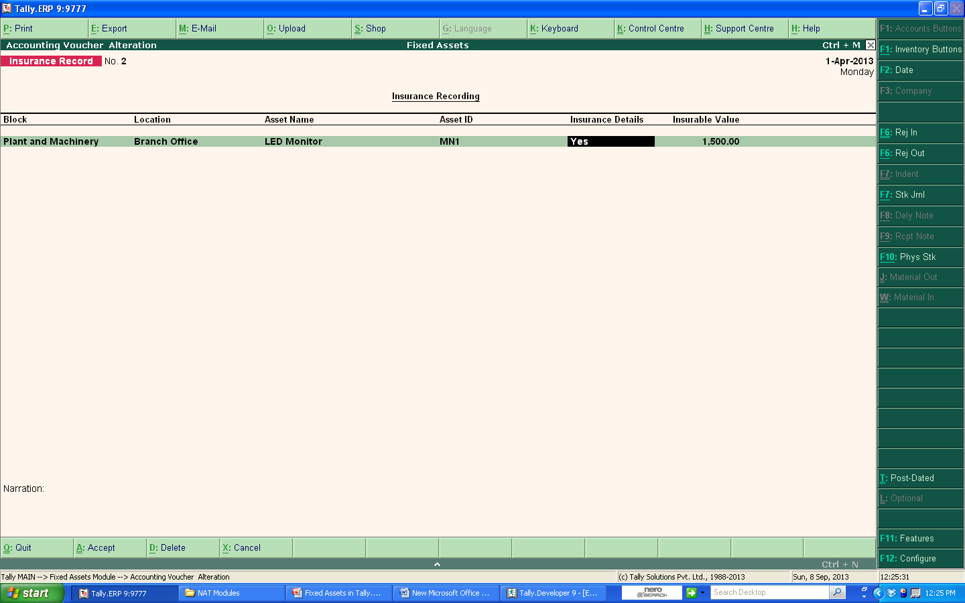
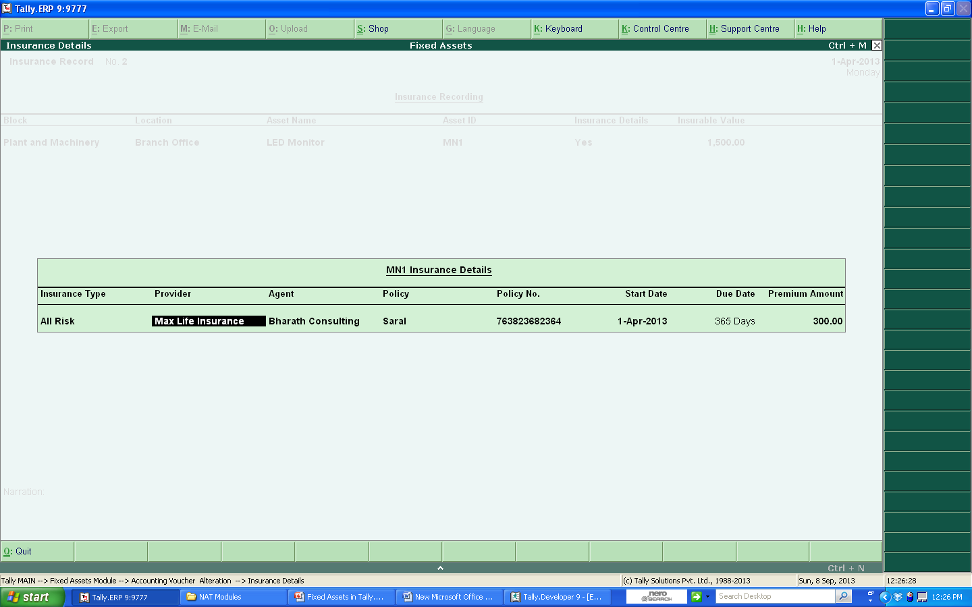
Insurance Details Recording
©New Access Technologies., All rights are reserved.

Slide 19
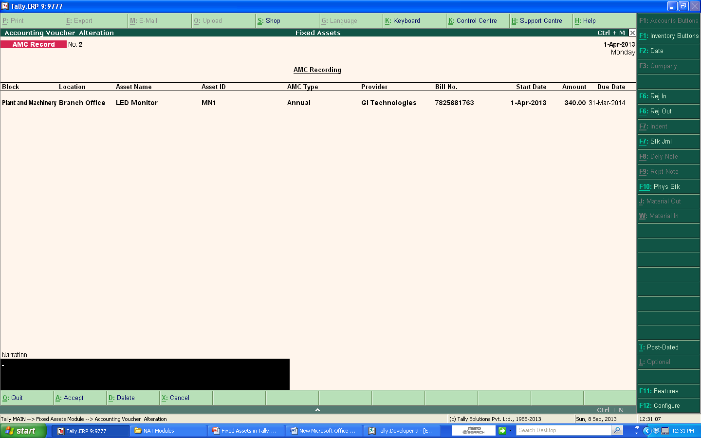
AMC Recording
©New Access Technologies., All rights are reserved.

Slide 20
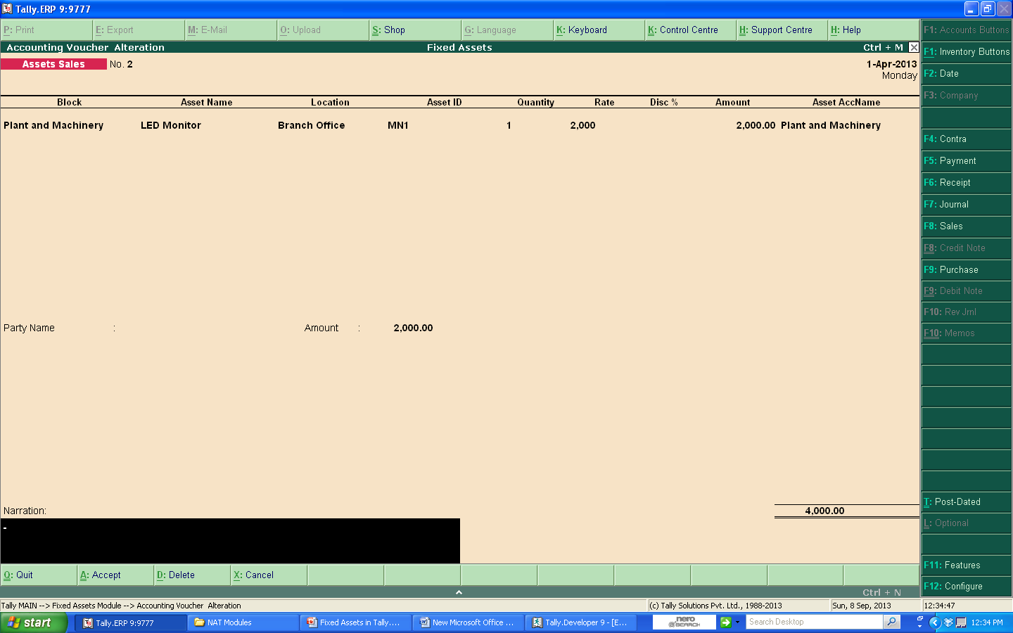
Sales Voucher Entry
©New Access Technologies., All rights are reserved.

Slide 21
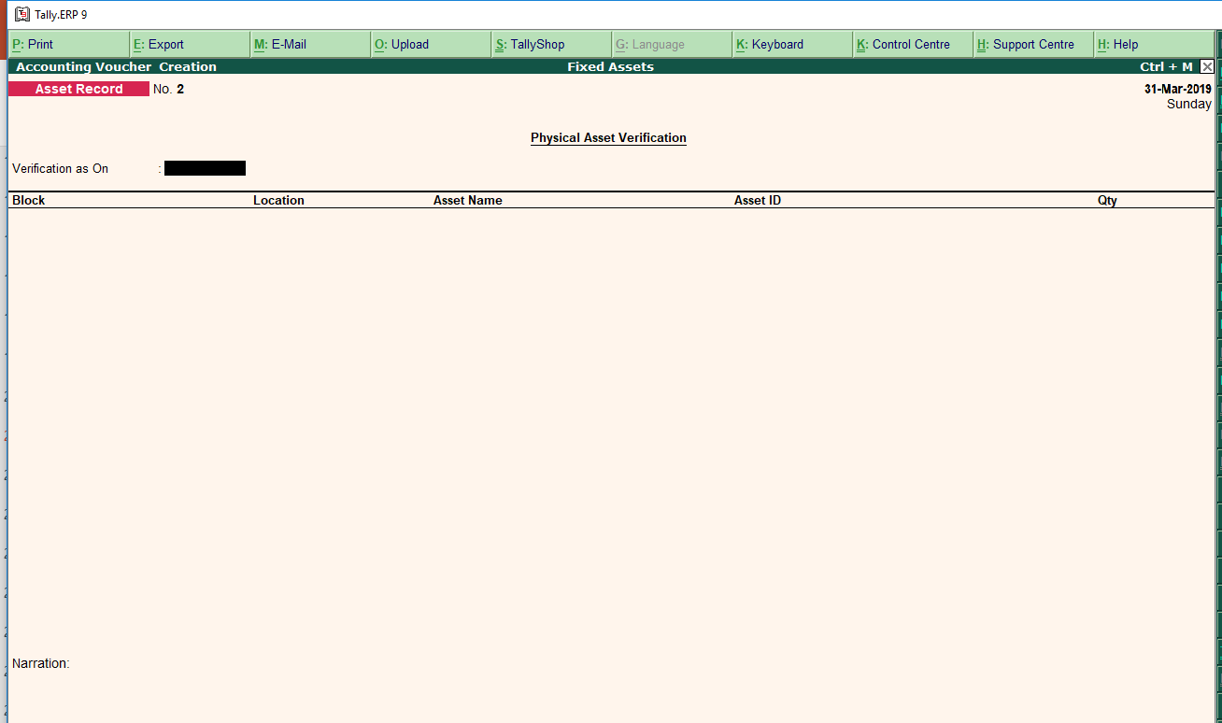
Physical Asset Verification

Slide 22
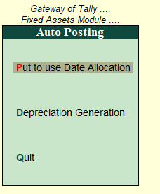
Auto Posting

Slide 23
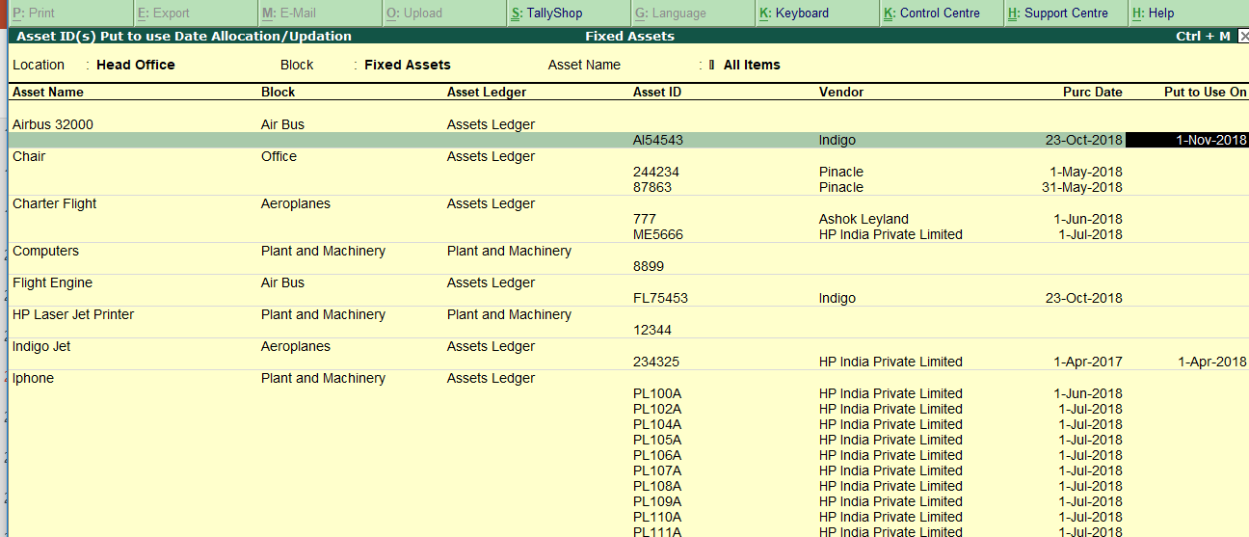
Put to Use Date Allocation

Slide 24
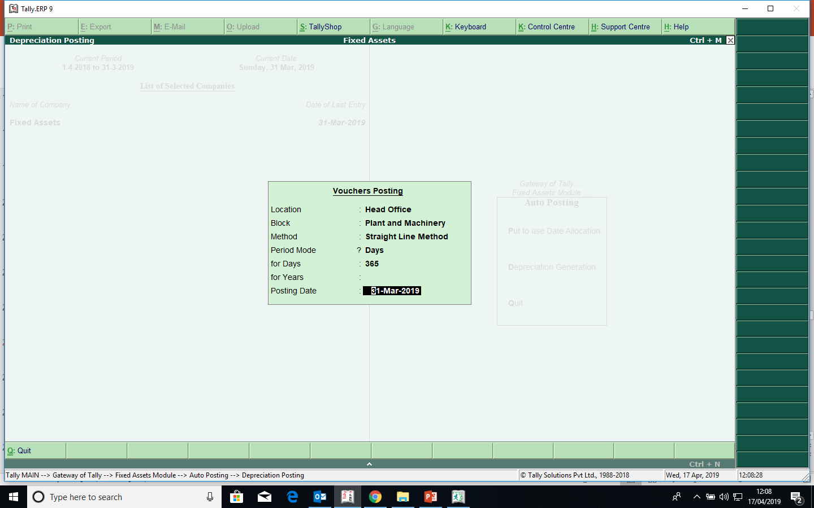
Depreciation Generation Automatically

Slide 25
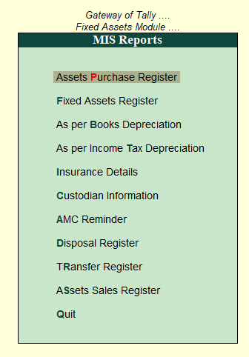
MIS Reports
©New Access Technologies., All rights are reserved.

Slide 26
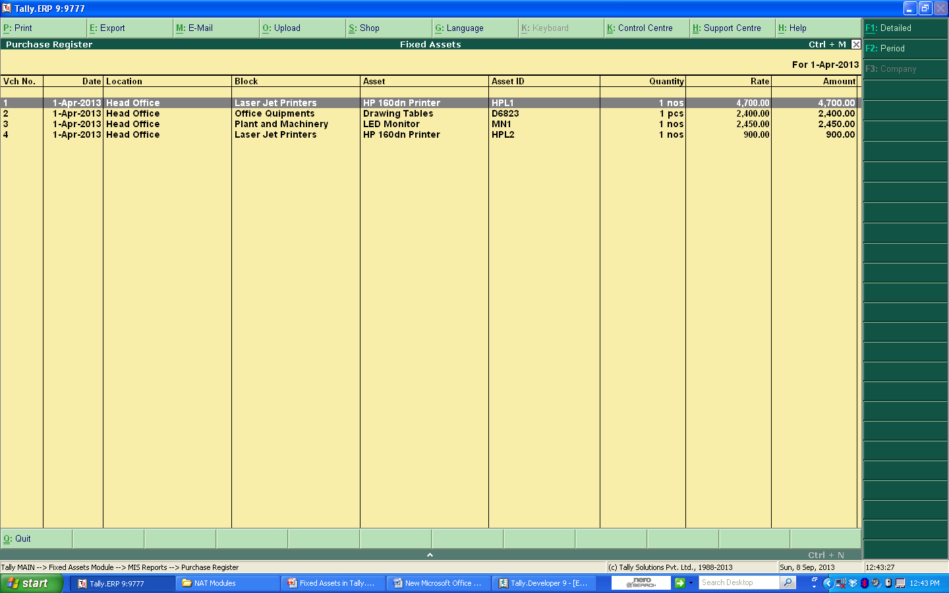
Purchase Register
©New Access Technologies., All rights are reserved.

Slide 27
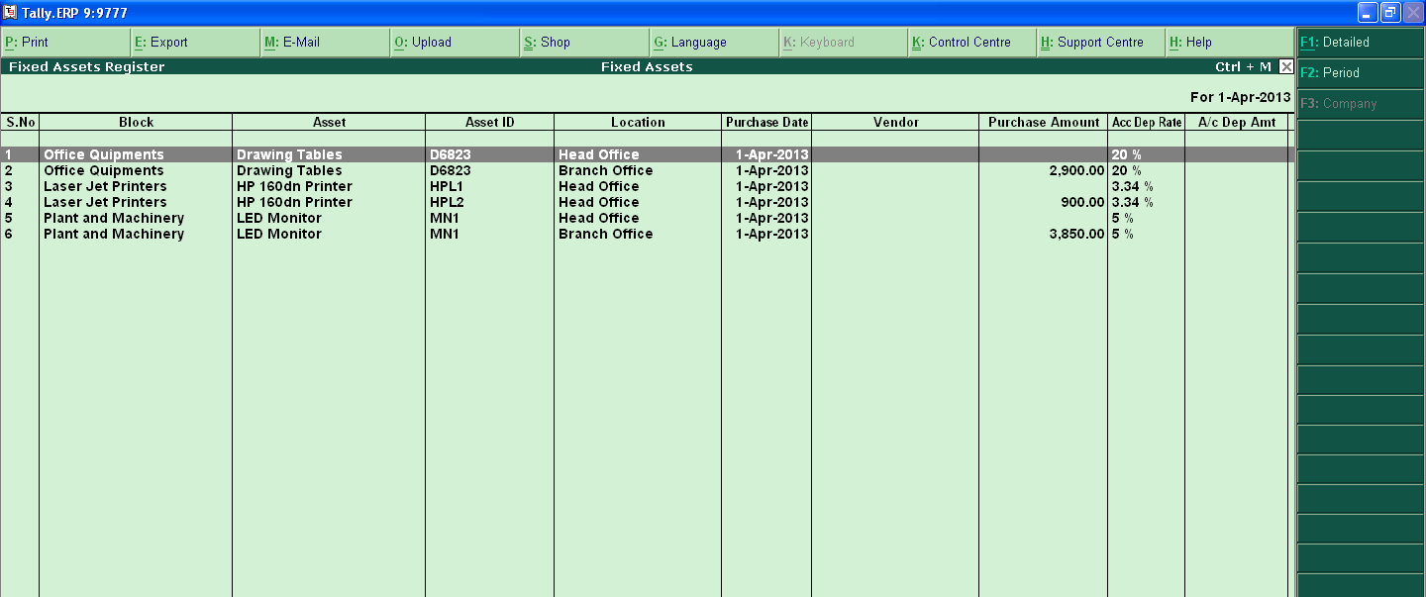
Fixed Assets Register
©New Access Technologies., All rights are reserved.

Slide 28
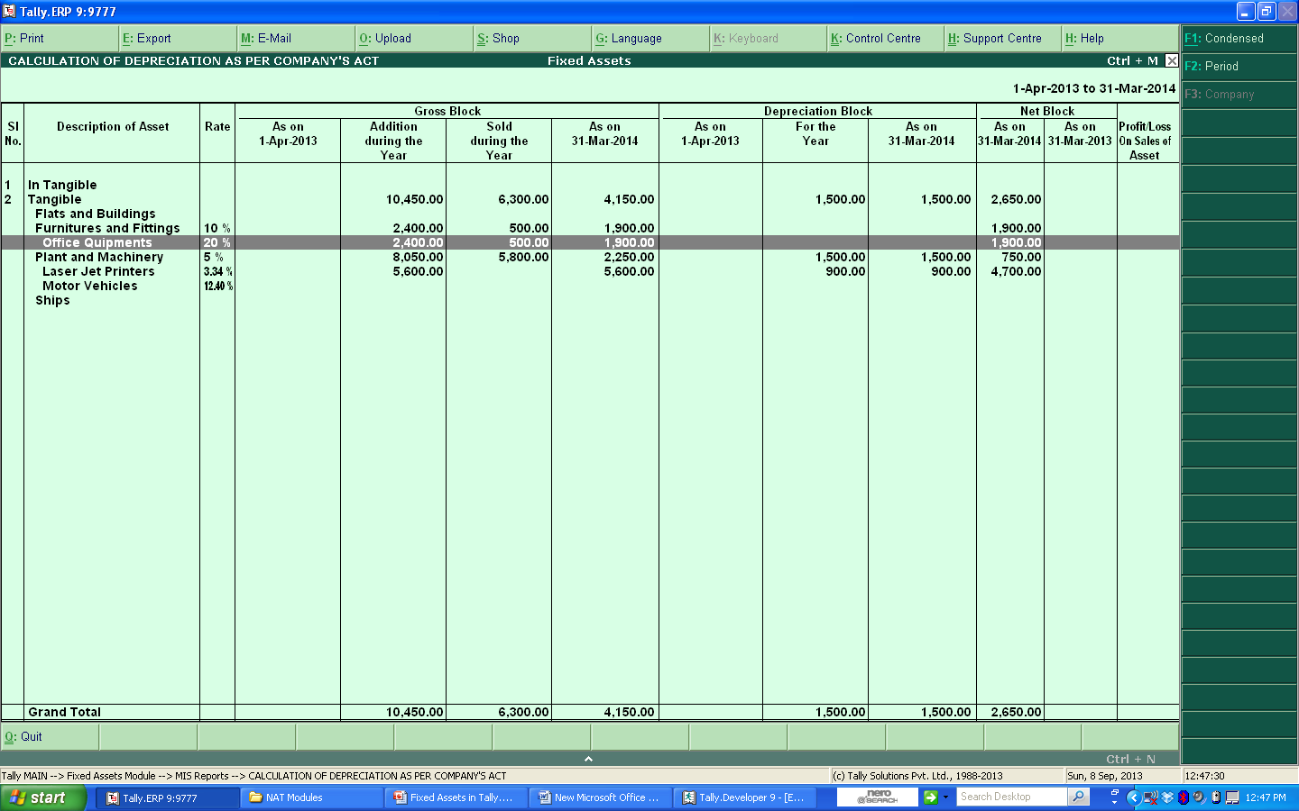
As per Books Depreciation
©New Access Technologies., All rights are reserved.

Slide 29
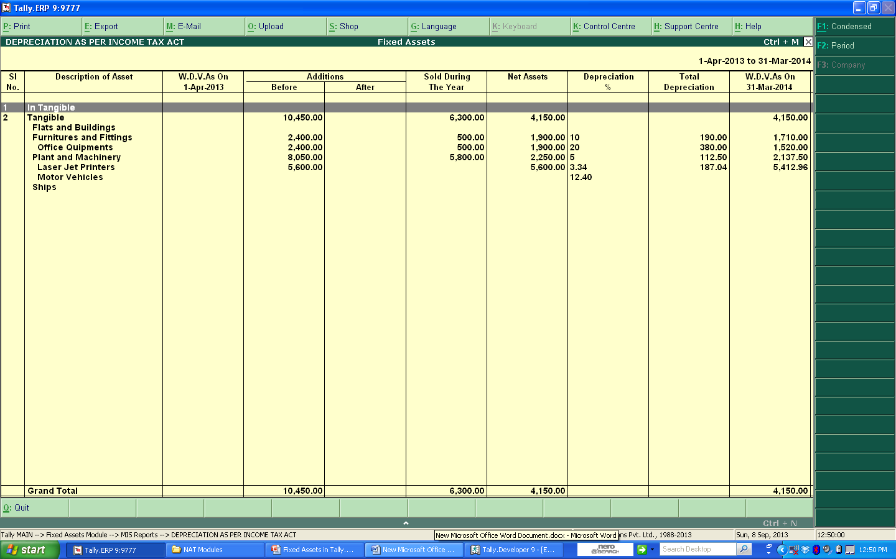
As per Income tax Depreciation
©New Access Technologies., All rights are reserved.

Slide 30
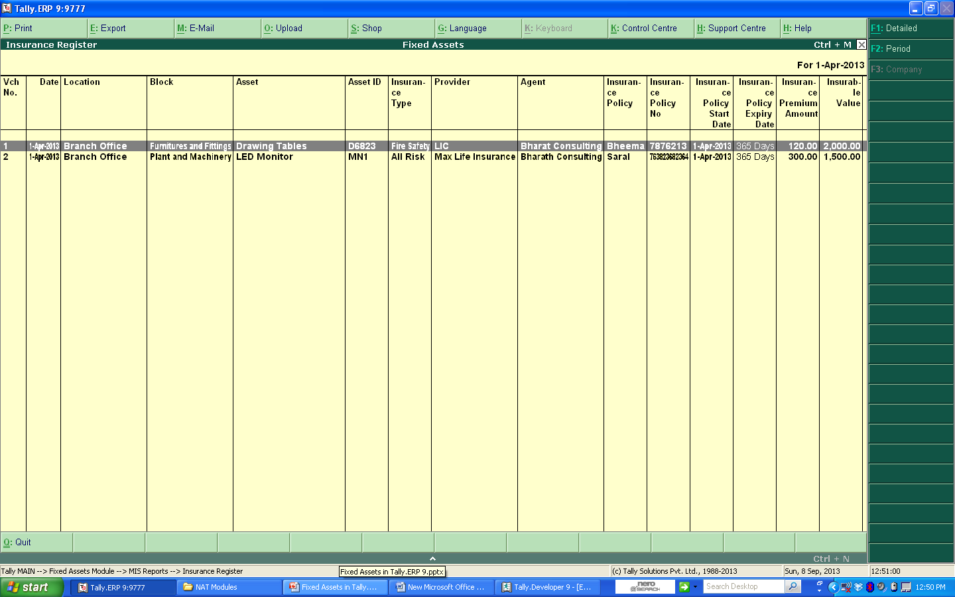
Insurance Details
©New Access Technologies., All rights are reserved.

Slide 31
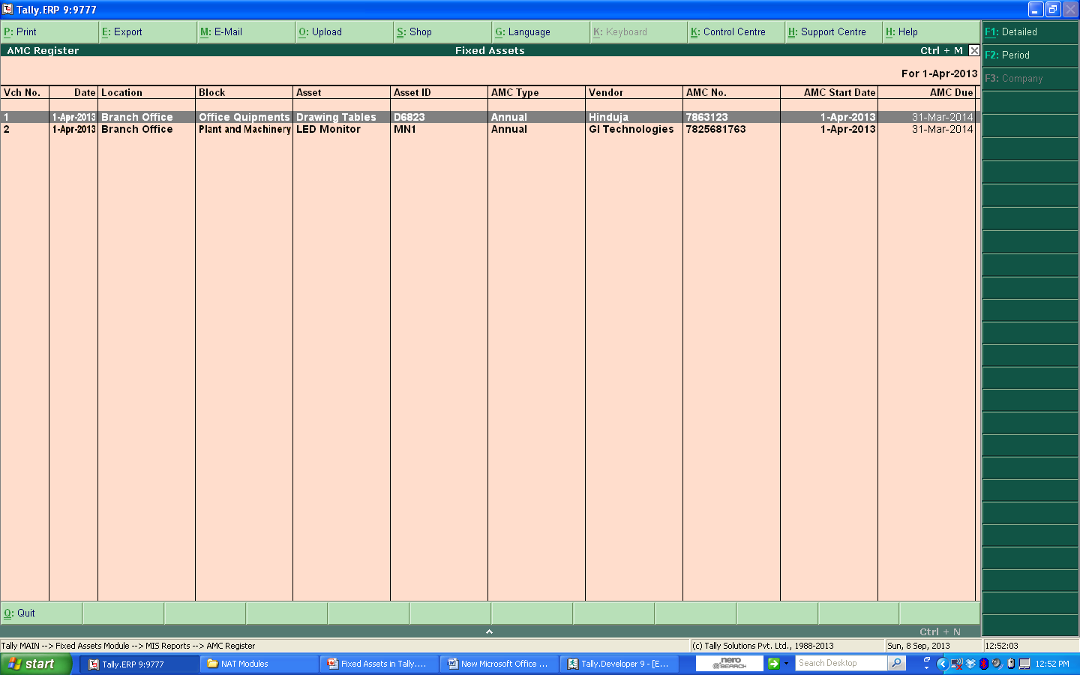
AMC Reminder
©New Access Technologies., All rights are reserved.

Slide 32
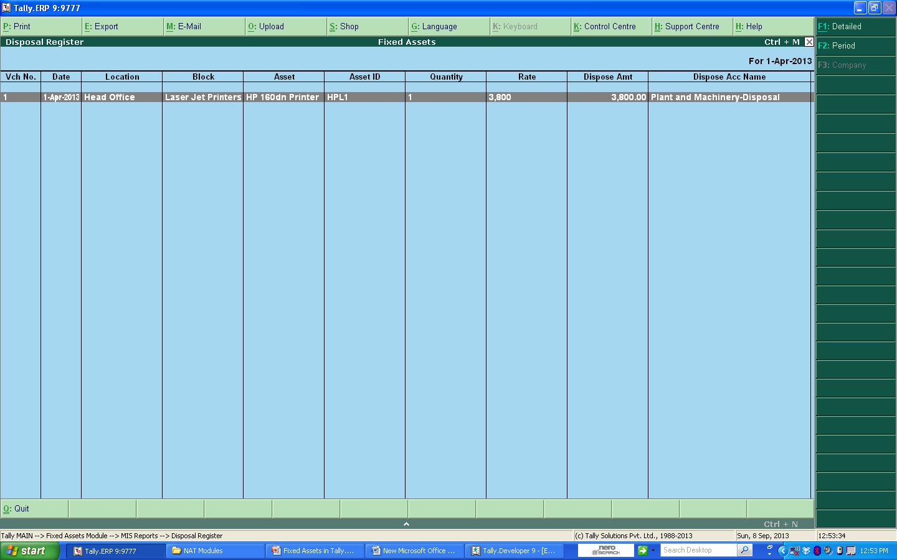
Disposal Register
©New Access Technologies., All rights are reserved.

Slide 33
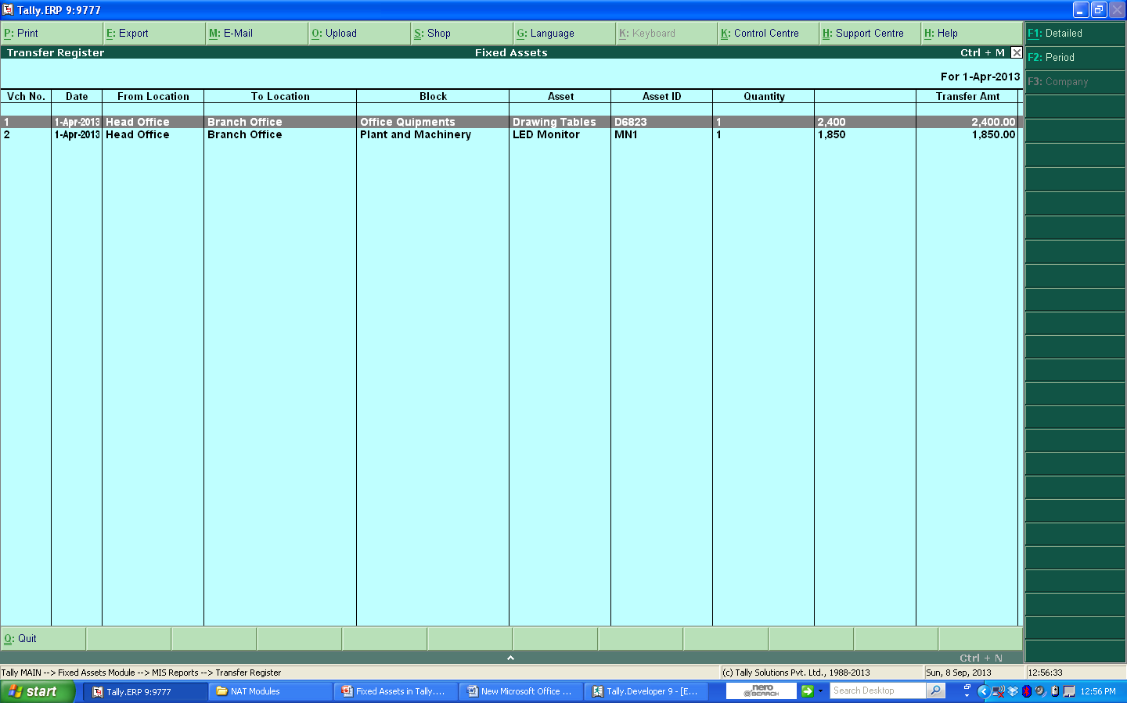
Transfer Register
©New Access Technologies., All rights are reserved.

Slide 34
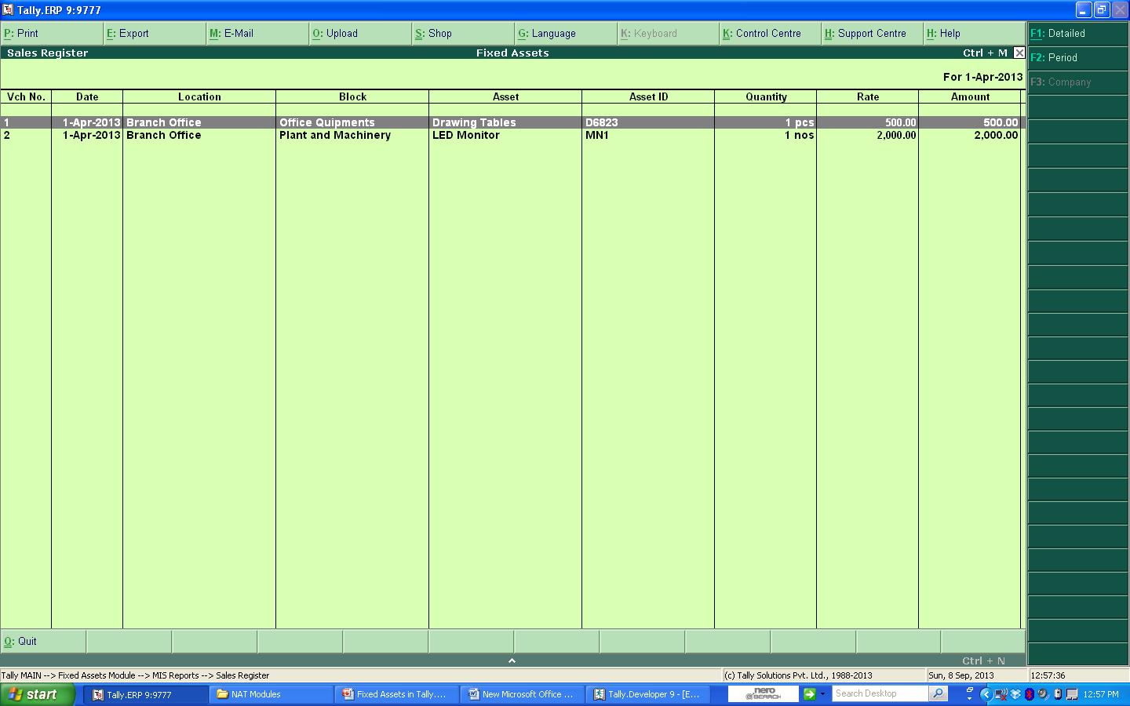
Assets Sales Register
©New Access Technologies., All rights are reserved.

Slide 35
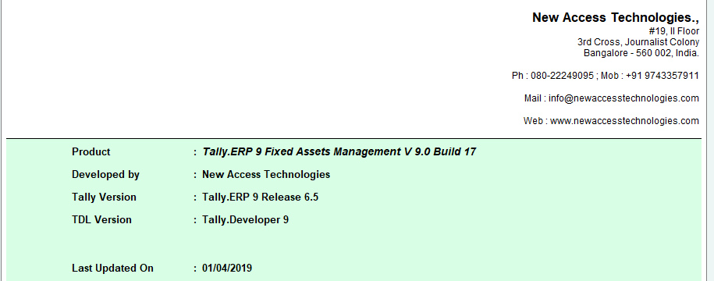
Release Info
©New Access Technologies., All rights are reserved.

Slide 36
Thank You
For any queries and for more details, visit :
http://www.newaccesstechnologies.com/fixed-assets-tally.html
©New Access Technologies., All rights are reserved.

